Slide 1
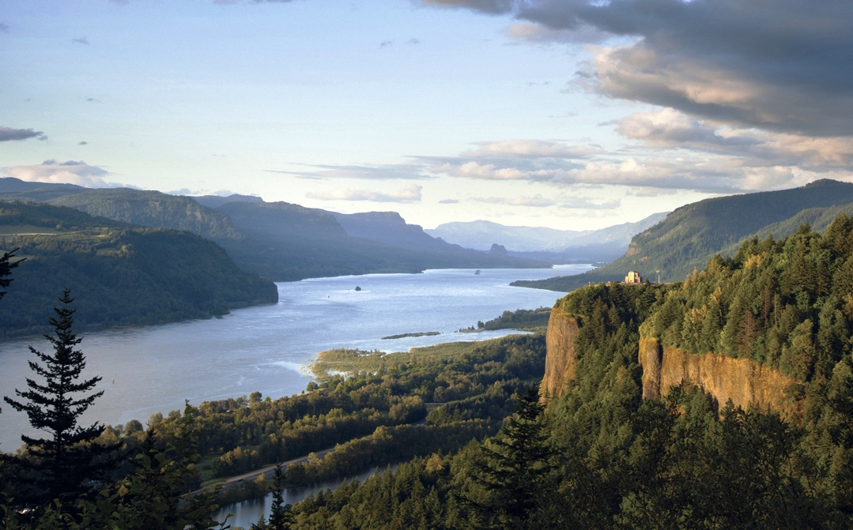



Columbia River Gorge Commission Meeting
Air Quality/Visibility Update on Columbia River Gorge
January 13, 2015
Vancouver WA
Oregon Department of Environmental Quality
Washington Department of Ecology
Washington Southwest Clean Air Agency

Slide 2
Update to the Commission
Presentation Outline
Recap of DEQ/SWCAA presentation to Commission on 9/9/14
“Visibility 101”- what is visibility & regional haze?
Summary of past Gorge air quality/visibility study (2004-2011)
Gorge visibility trends
Overview of OR/WA Regional Haze Plans
Update on PGE Boardman & Centralia BART
Update on upcoming regional haze work
Wrap up

Slide 3
Update to the Commission
Presentation Outline
Recap of DEQ/SWCAA presentation to Commission on 9/9/14
“Visibility 101”- what is visibility & regional haze?
Summary of past Gorge air quality/visibility study (2004-2011)
Gorge visibility trends
Overview of OR/WA Regional Haze Plans
Update on PGE Boardman & Centralia BART
Update on upcoming regional haze work
Wrap up

Slide 4
9/9/14 Meeting Recap
40 min presentation by directors of DEQ & SWCAA.
Emphasized Gorge protection is collaboration and partnership between air agencies and Forest Service.
Briefly summarized air quality in the Gorge:
  AQ is generally good and health standards being met.
  Air pollution affecting the Gorge is both local and distant.
  Visibility not getting worse in spite of regional growth.
Some visibility improvement under Regional Haze rules.
Goal is “continued improvement”.
Limited state agency resources to conduct more study on the Gorge – but can provide more background on previous work conducted (today’s meeting).

Slide 5
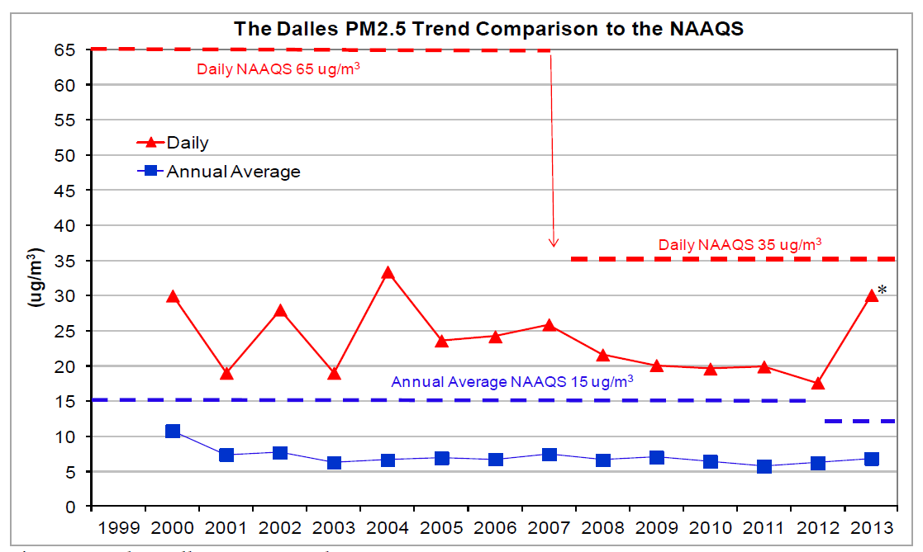
9/9/14 Meeting Recap
  Air Quality well under the Health Standard
In 2007, EPA lowered the 24-hr PM2.5 NAAQS to 35 ug/m³
* wildfire impact

Slide 6
Update to the Commission
Presentation Outline
Recap of DEQ/SWCAA presentation to Commission on 9/9/14
“Visibility 101”- what is visibility & regional haze?
Summary of past Gorge air quality/visibility study (2004-2011)
Gorge visibility trends
Overview of OR/WA Regional Haze Plans
Update on PGE Boardman & Centralia BART
Update on upcoming regional haze work
Wrap up

Slide 7
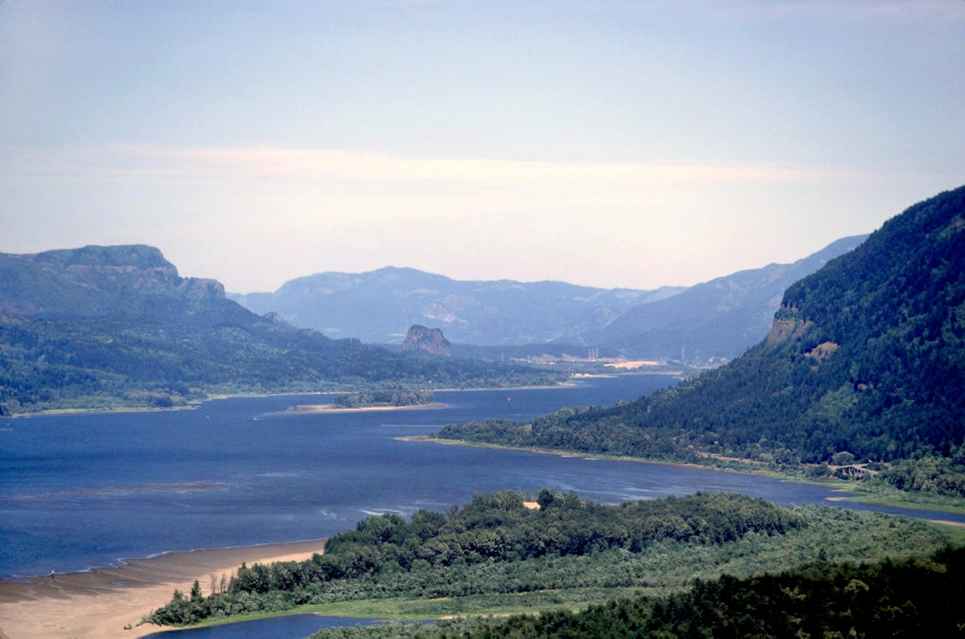
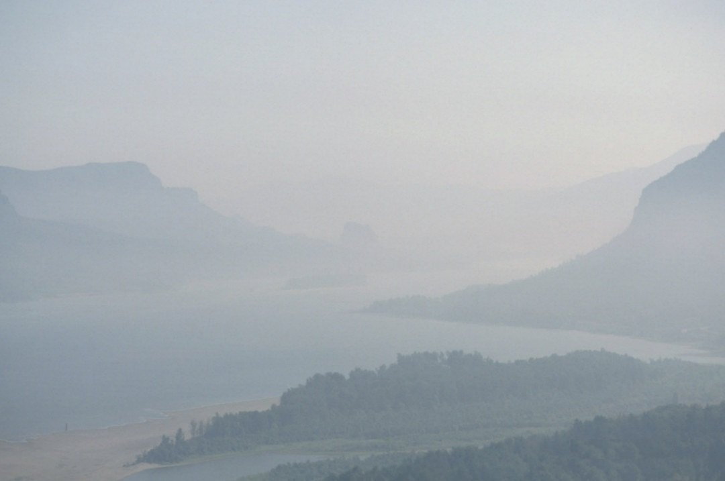
Visibility 101
Visibility is “how far” and “how well” you can see a distant object.
Scientifically: light scattering + light absorption = light extinction.
Good visibility = > 100 mi
Bad visibility = < 25 mi
(or 9 deciview)
(or 23 deciview)
Looking East from Vista House
7

Slide 8
What is Deciview (dv)?
Visibility 101
Similar to “decibel” for sound - based on what is a “perceptible” change to the naked eye.
1 deciview is perceptible to most people.
0.5 deciview is “limit of perceptible change”
Deciview (dv) vs. Viewing Distance (mi)
dv | 0 | 5 | 10 | 20 | 30 | 40 | 50
mi | 250 | 160 | 90 | 35 | 13 | 4-5 | 1-2
8

Slide 9
What is Regional Haze?
Visibility 101
Air pollution from many sources over large regions that travels into national parks and wilderness areas and affects visibility (the scenic view).
Small amounts of air pollution (well below health standards) have significant effect on visibility.
The best visibility is over 200 miles. Limited by the natural light scattering in the atmosphere.
  Natural sources also contribute to haze - wildfire, dust, sea salt.
9

Slide 10
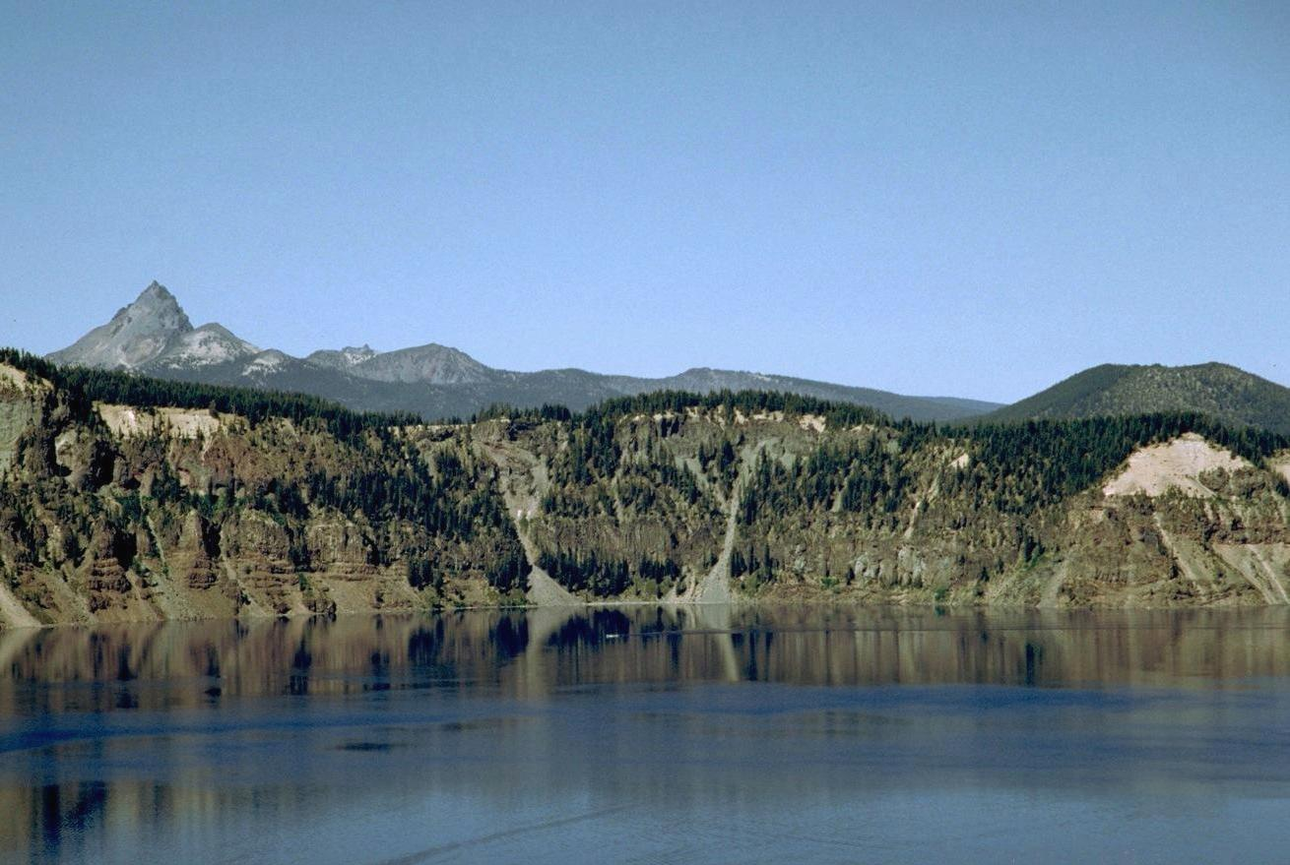
Visibility 101
What is Regional Haze?
5 dv = 150 miles
Crater Lake National Park
10

Slide 11
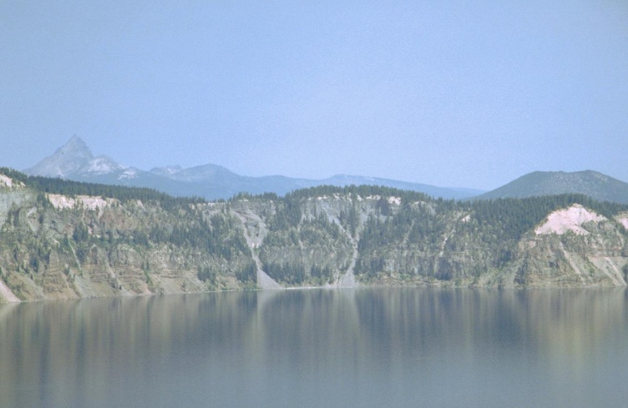
Visibility 101
What is Regional Haze?
20 dv = 35 miles
Crater Lake National Park
11

Slide 12
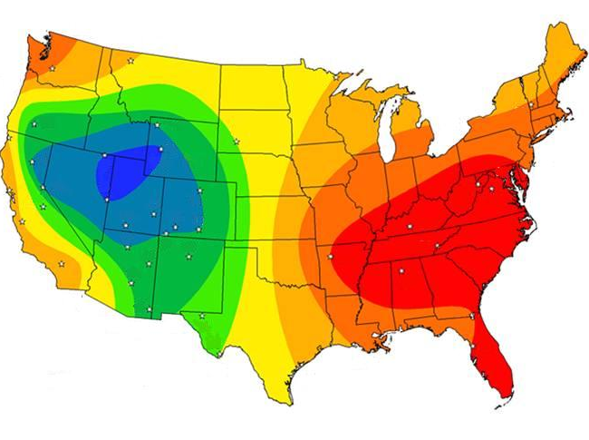
Visibility 101
Average Visibility in US
BEST
WORST
West
35-90 miles
East
15-30 miles
12
Source: Introduction to Visibility Report, 1999

Slide 13
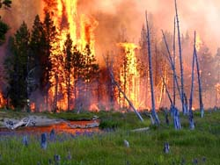
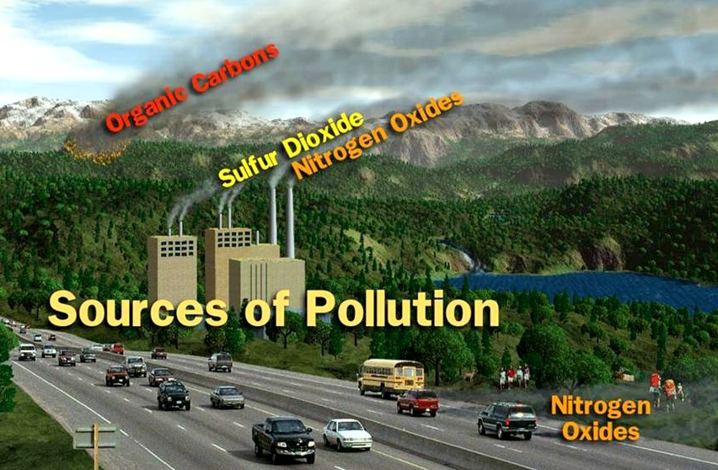
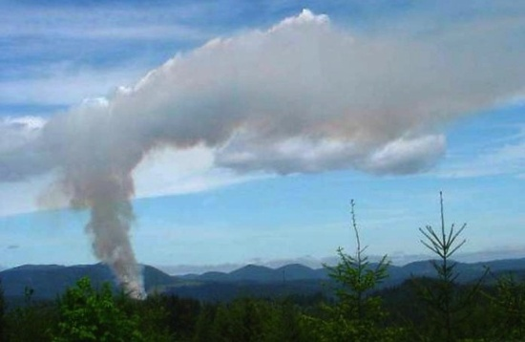
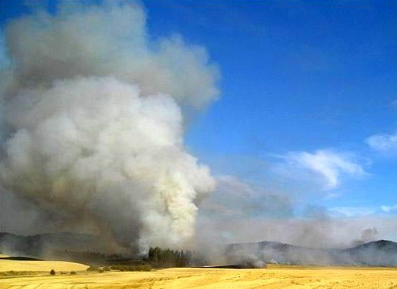
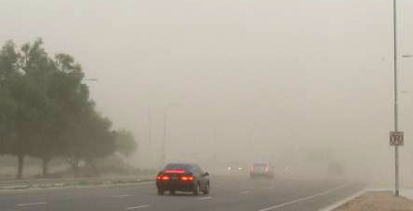
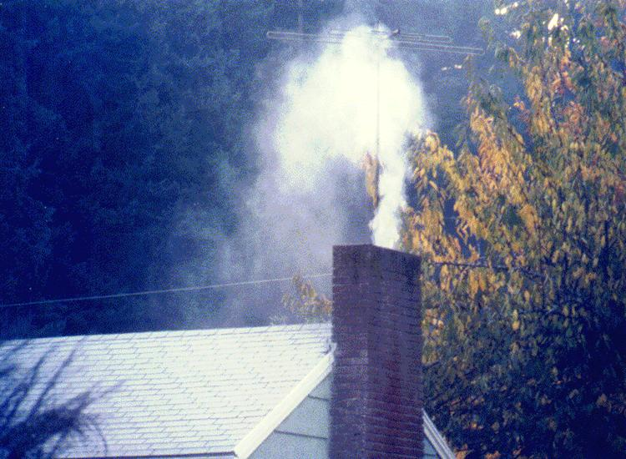
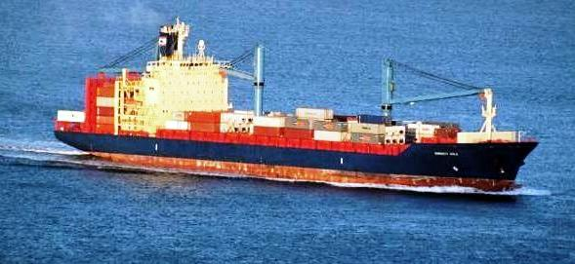
Visibility 101
Wildfire
Slash Burning
Motor Vehicles
Field Burning
Road Dust
Woodstoves
Shipping
13

Slide 14
Primary Pollutants Causing Haze
Visibility 101
Ammonium Sulfate:* SO₂ + ammonia, from combustion of fuels containing sulfur.
Ammonium Nitrate:* NOx + ammonia, from high temperature combustion processes.
Organic and Elemental Carbon:* mostly combustion due to fire (wildfire + forest, agricultural, other controlled burning, and woodstoves).
Fine Soil: dust from dirt roads, farmland, bare ground, dust storms.
Coarse Mass: larger dust particles.
* formed by gas-to-particle conversion in atmosphere
14

Slide 15
Visibility 101
Primary Pollutants Causing Haze
East Gorge (Wishram) 2013
Sulfates
Nitrates
Organic Carbon
Elemental Carbon
Coarse/dust
Fine Soil
Sea Salt
15

Slide 16
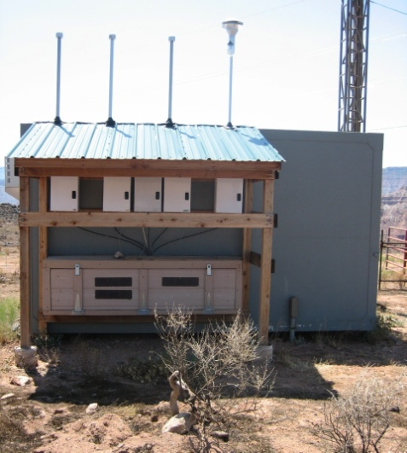
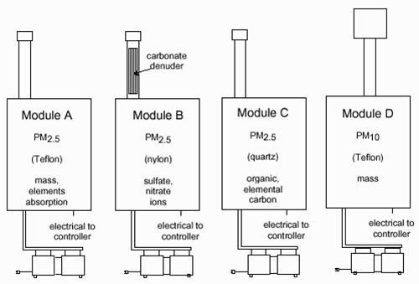
Visibility 101
Visibility Monitoring Network
“IMPROVE” Monitors
Interagency Monitoring of Protected Visual Environments
16

Slide 17
Update to the Commission
Presentation Outline
Recap of DEQ/SWCAA presentation to Commission on 9/9/14
“Visibility 101”- what is visibility & regional haze?
Summary of past Gorge air quality/visibility study (2004-2011)
Gorge visibility trends
Overview of OR/WA Regional Haze Plans
Update on PGE Boardman & Centralia BART
Update on upcoming regional haze work
Wrap up

Slide 18
Summary of Past Gorge Study
Background
  2000 Gorge Commission asked ODEQ and SWCAA to develop a regional strategy, based on the purposes of the National Scenic Area Act:
  Protect and enhance the scenic, cultural, natural, and recreational resources of the Columbia River Gorge and;
  Protect and support local economies by encouraging growth in existing urban areas in a manner consistent with (1) above.

Slide 19
Summary of Past Gorge Study
Timeline and Overview
  2000 Gorge Commission approves air quality amendment to NSA Management Plan to analyze Gorge visibility and develop a regional air quality strategy.
  2001-2003 Development of technical study work plan.
  2004-2007 Start of work. Prepared emission inventory, extensive air monitoring, and computer modeling.
2007 Gorge Science Day. Public meeting to discuss preliminary results and other studies on Gorge visibility
2008 Gorge Policy Day. Public meeting to review draft strategy
2011 DEQ & SWCAA present final report to the Commission.

Slide 20
Gorge Air Study Participants
Summary of Past Gorge Study
Desert Research Institute (DRI)
Environ International
National Oceanic and Atmospheric Administration (NOAA)
Washington Department of Ecology (WDOE)
Southwest Clean Air Agency (SWCAA)
US Forest Service (USFS)
Oregon Department of Environmental Quality (ODEQ)
Washington State University (WSU)
National Park Service (NPS)
UC Davis / Crocker Nuclear Laboratory

Slide 21
Summary of Past Gorge Study
Gorge Air Study and Strategy
Ambient Monitoring - 3 ambient sites plus 9 nephelometers
Objectives:
  Characterize meteorology throughout Gorge.
  Identify pollutants of concern.
  Identify source categories or regions of pollution sources.
  Identify elevated pollution episodes to evaluate using modeling.
Computer Modeling - MM5, SMOKE, MOBILE 6.2, and CAMx
Objectives:
    Source categories contributing to haze.
    Regions contributing to haze.
  Run “what if” scenarios for PGE Boardman, ammonia sources, on-road sources and major point sources in Portland-Vancouver and inside Gorge.

Slide 22
Modeling Domain
Summary of Past Gorge Study
4 kM domain red = local
12 kM domain green = regional
36 kM domain gray = super regional

Slide 23
Summary of Past Gorge Study
Study Monitoring Map

Slide 24
Monitoring Results
Summary of Past Gorge Study
Major Haze Causing Pollutants in Gorge:
Organic carbon, sulfates, and nitrates
Organic mass large contributor in all seasons with a peak in fall from wood smoke and autos
Sulfate is a significant contributor in all seasons
Nitrate is more important in fall and winter
Coarse mass and carbon less important

Slide 25
Study Findings
Summary of Past Gorge Study
Two distinct seasons identified – each unique in magnitude of haze and contributors.
  Two significant events identified and evaluated through modeling:
      August 10 to 20, 2004
      November 4 to18, 2004

Slide 26
August 2004 Episode from Science Summary Report P 53
Summary of Past Gorge Study
Figure 4‑13. Time series of b_{sp}­ (light absorption coefficient) at selected sites for the August 2004 episode.

Slide 27
November 2004 Episode from Science Summary Report P 48
Summary of Past Gorge Study
Figure 4‑8. Daily average particle light scattering (b_{sp} - light absorption coefficient) for the November 2004 episode. Also shown is wind pattern type where 1 is strong westerly to 5 being strong (winter) easterly.

Slide 28
Study Findings
Summary of Past Gorge Study
Source categories found to be contributing to haze:
Electric Generating Units (EGUs)
  Power plants – coal, oil, natural gas
Point sources
  Major industrial facilities – pulp mills, steel mills
Non-road sources
  Marine engines, construction equipment, train engines
Motor vehicles
Distant sources (other states, Canada, beyond)
Natural sources
  Wildfires, volcanoes
Other sources
  Individual sources that are less than 1%

Slide 29
Source Contributions for August 2004 from Gorge Strategy Document 2011
Summary of Past Gorge Study
Figure 5: East end of Gorge (Aug 2004)
Figure 6: West end of Gorge (Aug 2004)

Slide 30
Source Contributions for November 2004 from Gorge Strategy Document 2011
Summary of Past Gorge Study
Figure 3: East end of Gorge (Nov 2004)
Figure 4: West end of Gorge (Nov 2004)

Slide 31
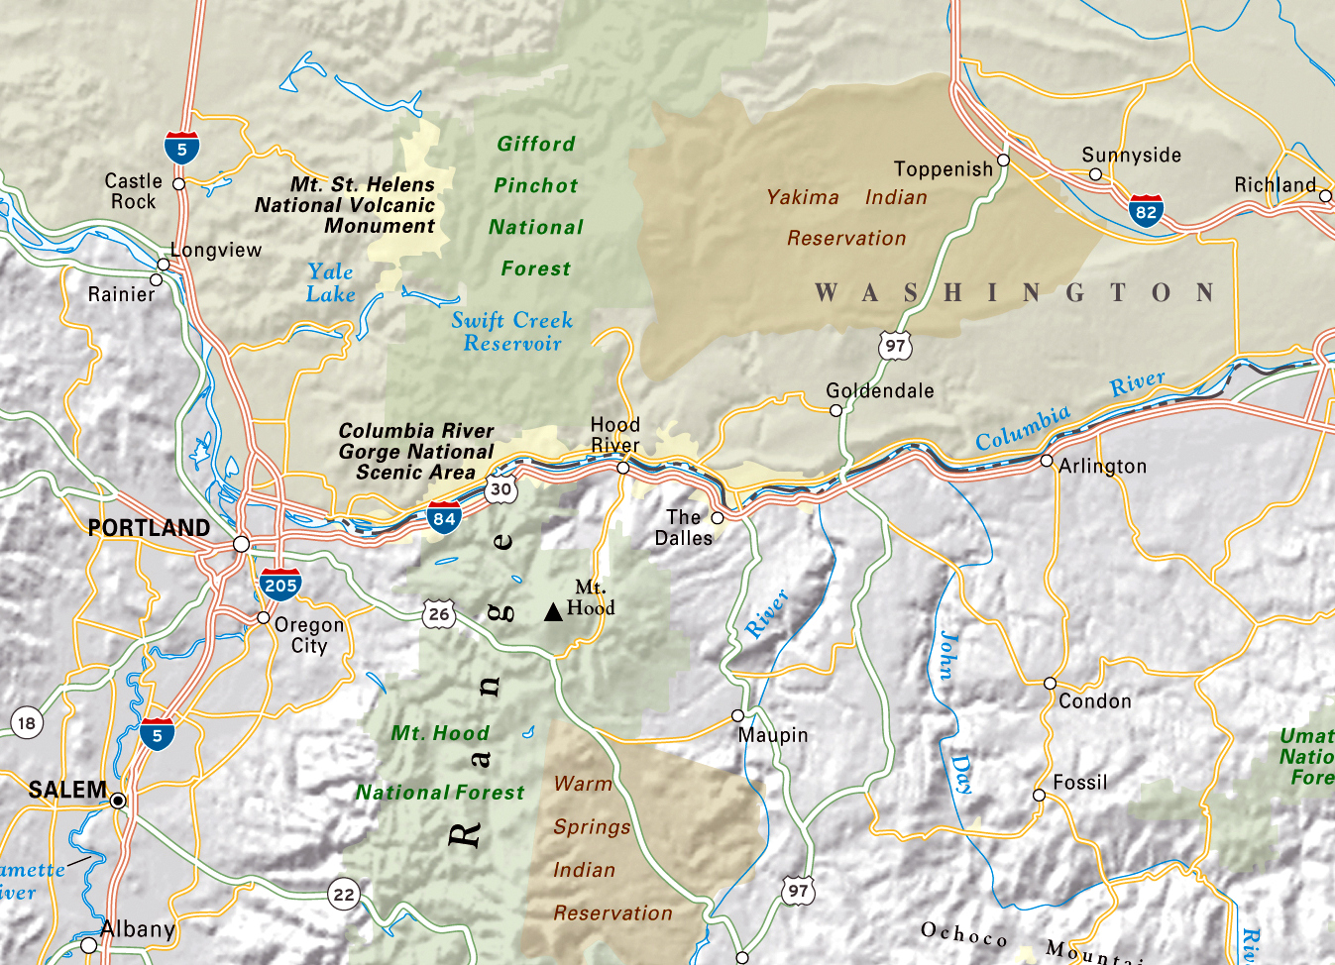
Local and Distant Contribution
Summary of Past Gorge Study
Offshore Shipping & International Transport
I-5 Corridor to North
Other Western States and Canada transport
Eastern Oregon/
Washington
Portland - Vancouver Area
Inside Gorge
Willamette Valley

Slide 32
Current rules & programs addressing the major contributing sources
Summary of Past Gorge Study
EMISSION SOURCE | REGULATORY PROGRAM/RULES
Distant & Regional Sources | Federal Regional Haze Program
Electric Generating Units | OR & WA Regional Haze Plans - BART
Non-road Sources: construction equipment farming equipment locomotive engines marine engines | Ultra-low Sulfur Diesel Fuel Federal Clean Engine Rules Diesel Retrofits for Tugboats and Locomotives New EPA emission standards for offshore shipping Columbia River Clean Diesel Project
Area Sources: woodstoves open burning misc. industrial & commercial, manufacturing | Federal Air Toxics Source Standards State woodstove emission reduction programs

Slide 33
Current rules & programs addressing the major contributing sources
Summary of Past Gorge Study
EMISSION SOURCE | REGULATORY PROGRAM/RULES
On-Road Vehicles | Motor Vehicle Inspection Program in the Portland Metro Area– Fleet Turnover Low Emission Vehicle Standards Ultra-low Sulfur Fuel Diesel Retrofit on School Buses Diesel Retrofits for Local Government Fleets Low Carbon Fuel Standard
Forestry Burning | Gorge smoke management protection under state programs in OR & WA
Portland/Vancouver-area Emissions | Portland Air Toxics Solutions Plan Portland and Vancouver Ozone Maintenance Plan Columbia River Clean Diesel Project

Slide 34
Current rules & programs addressing the major contributing sources
Summary of Past Gorge Study
EMISSION SOURCE | REGULATORY PROGRAM/RULES
Ammonia agricultural operations (fertilizer) dairy operations | Best Management Practices (BMPs)
Industrial Point Sources pulp & paper mills boilers secondary aluminum plants | New Source Review/PSD for new/modified sources Regional Haze Program – BART and non-BART sources Federal Air Toxics Source Standards

Slide 35
Study Findings
Summary of Past Gorge Study
Pollutants most contributing to haze are sulfates and nitrates. Nitrates worse in winter in east.
Sources contributing to haze are both local and distant.
Moisture/humidity/fog plays a major role in haze formation
Biogenic/natural sources contribute up to 70% of haze during certain worst case days.
PGE Boardman power plant was most significant individual contributor to haze.
Eliminating all industrial emissions near the Gorge will not substantially improve haze.

Slide 36
Study Conclusions
Summary of past Gorge study
Projections indicate slight improvement in visibility despite regional growth.
Visibility benefits come from numerous AQ rules and programs already in place – no “silver bullet” to significantly improve visibility in the Gorge.
Progress for reducing haze in Gorge will be tracked and periodically evaluated under the ongoing regional haze planning process.
Air agencies concluded the federal regional haze program is the regional air quality strategy that will best help carry out the purposes of Scenic Area Act.

Slide 37
Gorge Study Resources
Summary of past Gorge study
Oregon Department of Environmental Quality
  www.deq.state.or.us/aq/gorgeair/
Southwest Clean Air Agency
  www.swcleanair.org/Pages/ReportsStudies/ColumbiaRiverGorge/
US Forest Service
  www.fsvisimages.com/fstemplate.aspx?site=cori1
National Park Service – Colorado State University
  www.vista.cira.colostate.edu/improve/Education/IntroToVisinstr.htm
Desert Research Institute – Causes of Haze
  www.coha.dri.edu

Slide 38
List of key Gorge Studies
Summary of past Gorge study
Columbia Gorge Air Strategy Document - September 2011
Draft Gorge Strategy Document – February 2008
Science Summary Report – February 2008
Gorge Air Quality Emission Inventory Report – January 2008
Gorge Modeling Report – August 2007
Causes of Haze in the Gorge (CoHaGo) Report – July 2006

Slide 39
Update to the Commission
Presentation Outline
Recap of DEQ/SWCAA presentation to Commission on 9/9/14
“Visibility 101”- what is visibility & regional haze?
Summary of past Gorge air quality/visibility study (2004-2011)
Gorge visibility trends
Overview of OR/WA Regional Haze Plans
Update on PGE Boardman & Centralia BART
Update on upcoming regional haze work
Wrap up

Slide 40
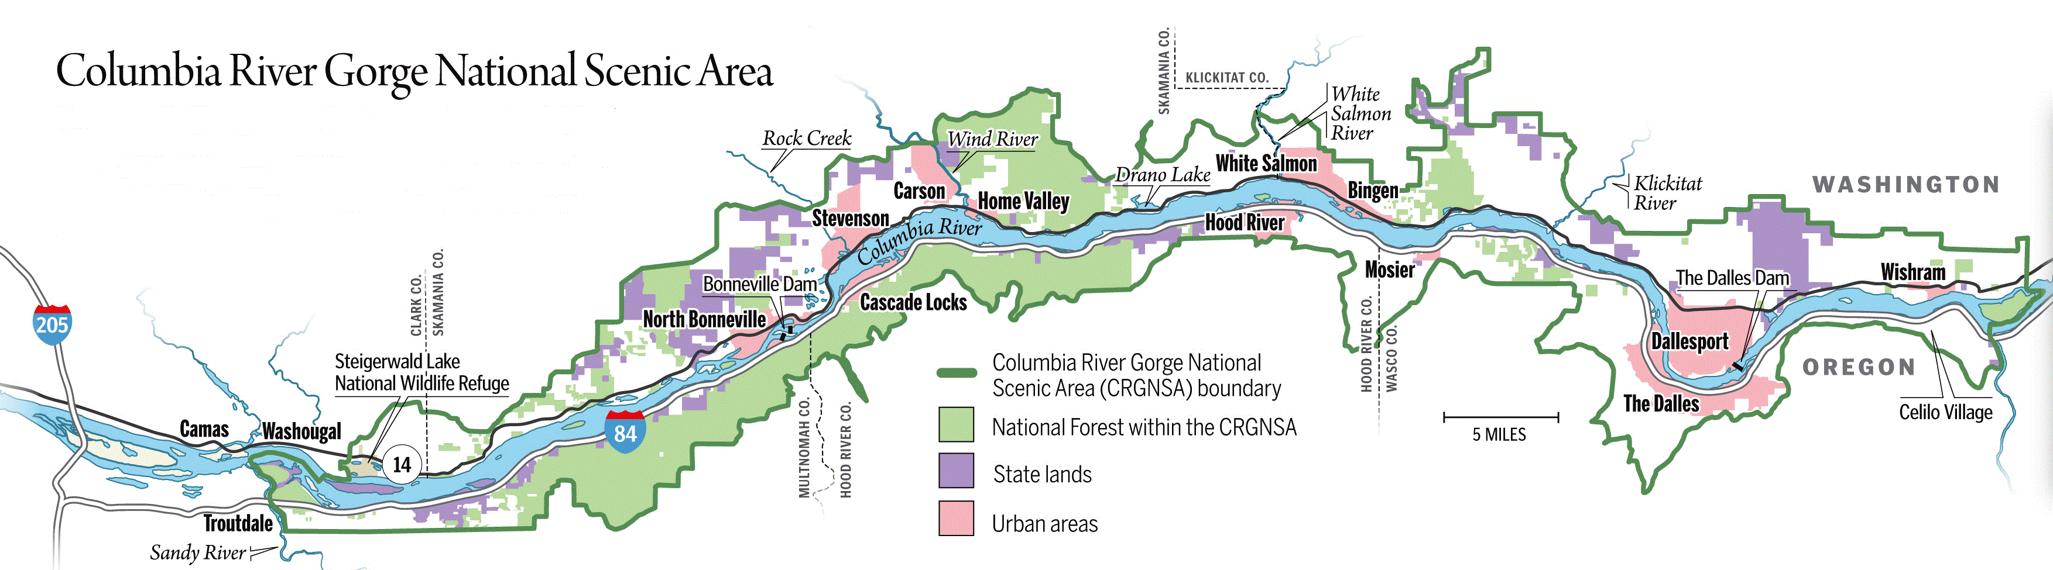

Gorge Visibility Monitoring
Current Gorge monitoring map
Eastside
Wishram site
Westside
Mt Zion site
(closed 2009)
Portland
Mt. Hood Class I Area site

Slide 41
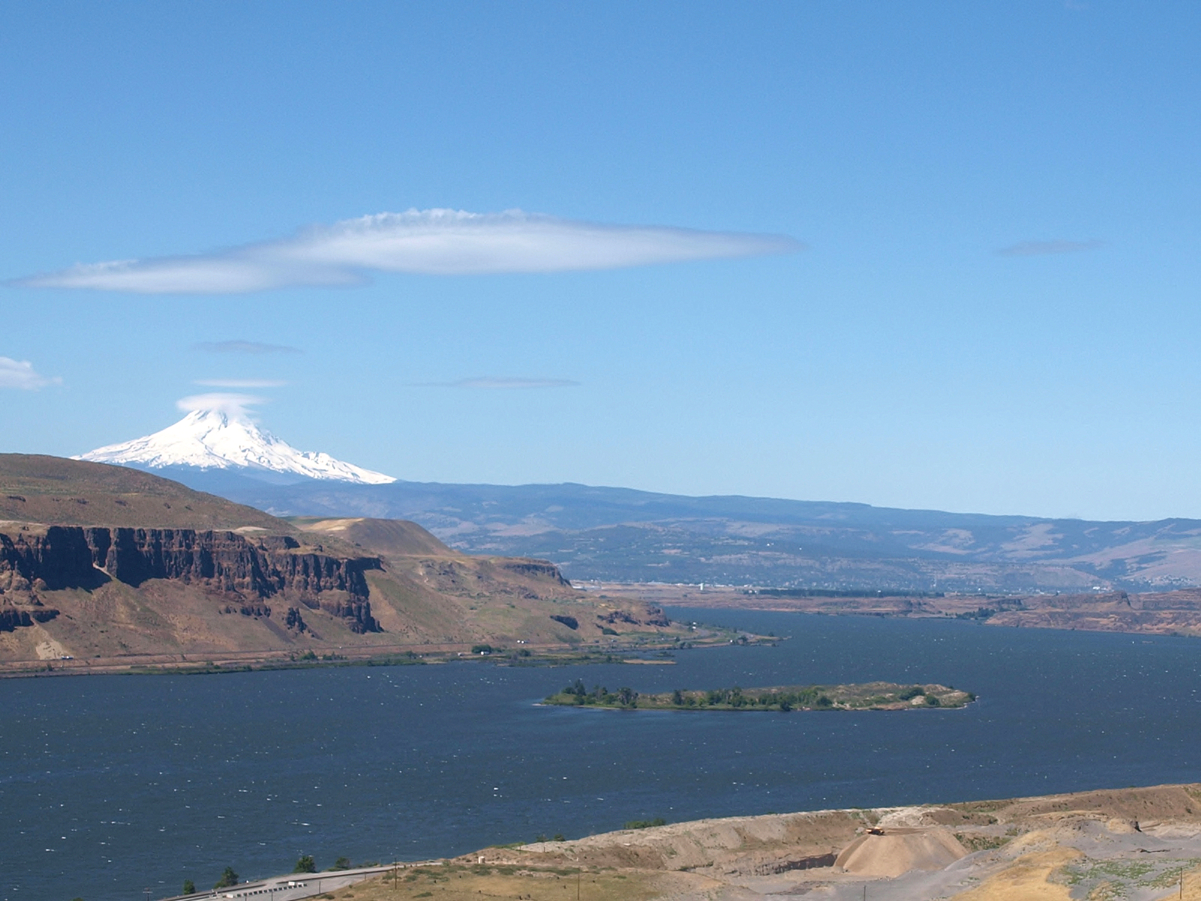
Gorge Visibility Monitoring
View from Wishram monitor site
Looking southwest
Mt. Hood
The Dalles

Slide 42
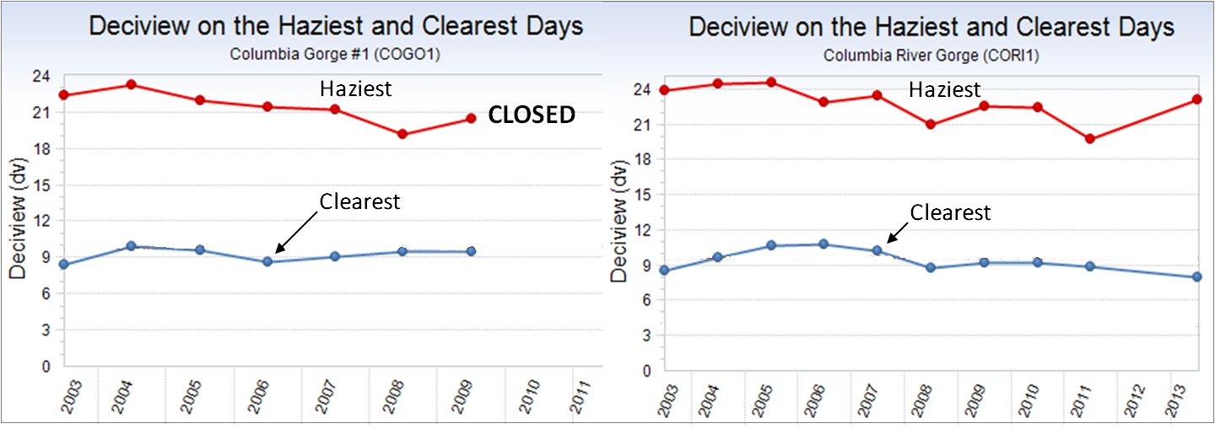
Gorge Visibility Trends
20% Haziest vs 20% Clearest Days
West Gorge (Mt Zion)
East Gorge (Wishram)
10-year trend: 2003-2013
Source: IMPROVE data, FLM Environmental Database
http://views.cira.colostate.edu/fed/

Slide 43
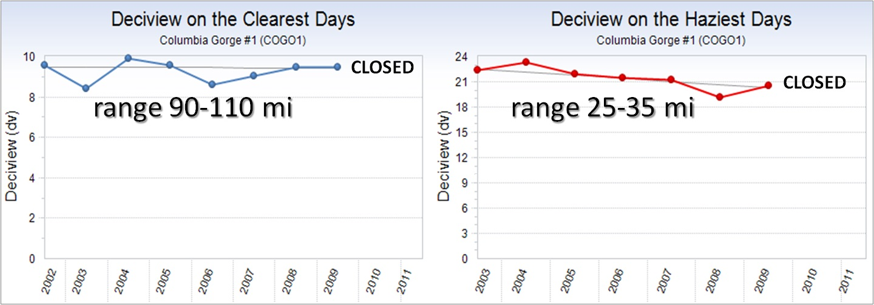
Gorge Visibility Trends
20% Haziest vs 20% Clearest Days
West Gorge (Mt Zion)
10-year trend: 2003-2013
Source: IMPROVE data, FLM Environmental Database
http://views.cira.colostate.edu/fed/

Slide 44
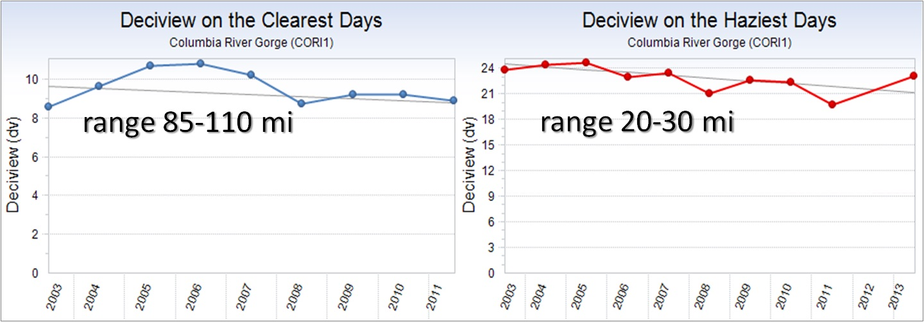
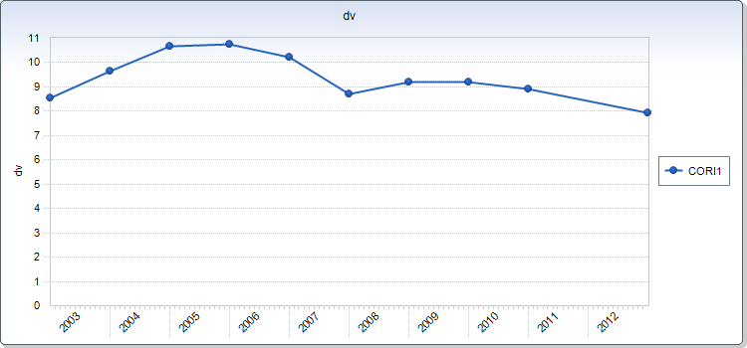
Gorge Visibility Trends
20% Haziest vs 20% Clearest Days
East Gorge (Wishram)
range 85-110 mi
10-year trend: 2003-2013
Source: IMPROVE data, FLM Environmental Database
http://views.cira.colostate.edu/fed/

Slide 45
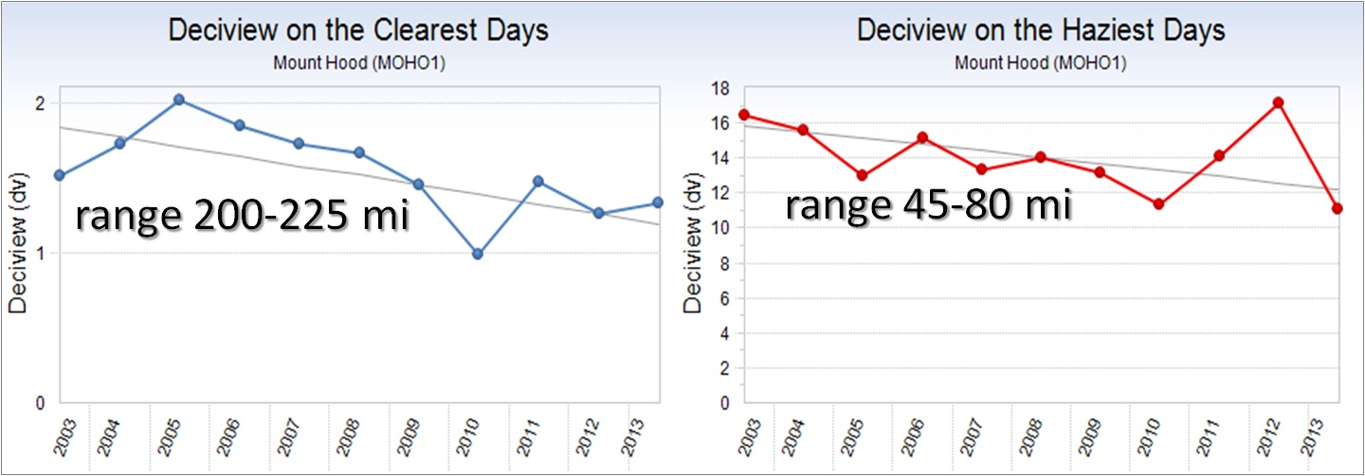
Gorge Visibility Trends
20% Haziest vs 20% Clearest Days
Mt Hood Class I Area
10-year trend: 2003-2013
Source: IMPROVE data, FLM Environmental Database
http://views.cira.colostate.edu/fed/

Slide 46
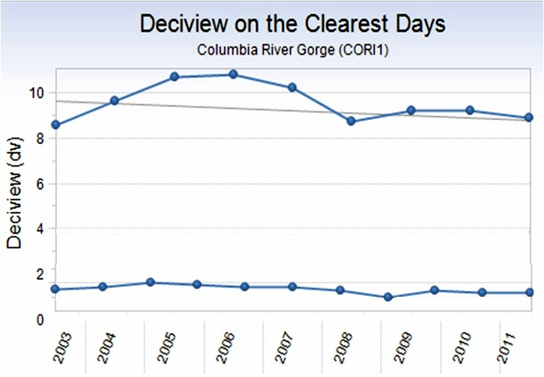
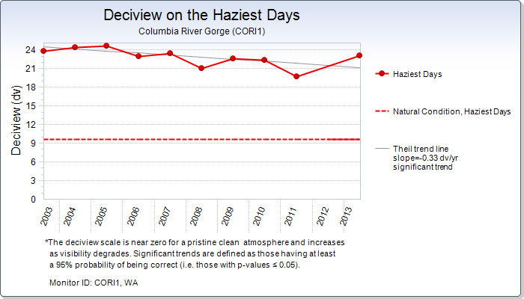
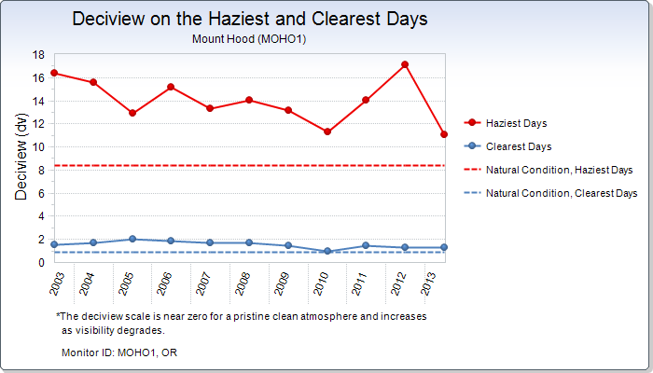
Gorge Visibility Trends
Chart Data: MOHO1
Chart Data: MOHO1
20% Haziest vs 20% Clearest Days
East Gorge (Wishram) vs Mt Hood Class I Area
range 85-110 mi
range 20-30 mi
range 200-225 mi
Mt Hood
range 45-80 mi
Mt Hood
10-year trend: 2003-2013
Source: IMPROVE data, FLM Environmental Database
http://views.cira.colostate.edu/fed/

Slide 47
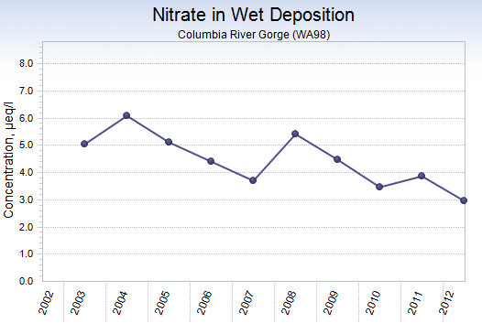
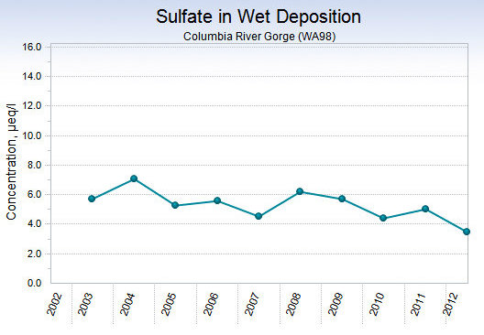
Gorge Visibility Trends
Nitrate and Sulfate Deposition
Gorge NADP WA98 monitoring site
10-year trend: 2003-2013
Source: IMPROVE data, FLM Environmental Database
http://views.cira.colostate.edu/fed/

Slide 48
Gorge Visibility Trends
Chart Data: CORI1
Chart Data: CORI1
Chart Data: CORI1
SUMMARY
For haziest and clearest visibility days, West side is slightly better than East.
Slight improving trend both sides (West closed in 2009) and expected to continue.
East side monitor is good location for tracking future trends, and the effect of Boardman.
Mt Hood Class I Area significantly better visibility than Gorge (no surprise).
Nitrate and Sulfate deposition is decreasing.

Slide 49
Update to the Commission
Presentation Outline
Recap of DEQ/SWCAA presentation to Commission on 9/9/14
“Visibility 101”- what is visibility & regional haze?
Summary of past Gorge air quality/visibility study (2004-2011)
Gorge visibility trends
Overview of OR/WA Regional Haze Plans
Update on PGE Boardman & Centralia BART
Update on upcoming regional haze work
Wrap up

Slide 50
Oregon/Washington RH Plans
Overview of EPA’s Regional Haze Rule
Adopted in 1999 - to address visibility problems in all156 Class I Areas over next 60 years.

Slide 51
What’s a Class I Area?
Oregon/Washington RH Plans
Areas designated by Congress on August 7, 1977
  National Parks over 5,000 acres
  Wilderness areas over 6,000 acres
Identified visibility as an important value in these natural areas.
A total of 156 Class I areas in the country.
Oregon has 12 Class I areas.
Washington has 8 Class I areas.
51

Slide 52
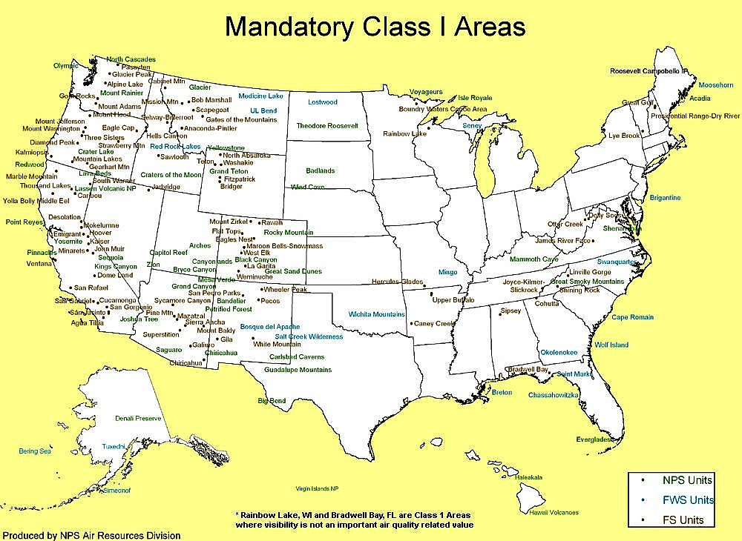
Oregon/Washington RH Plans
156 Class I Areas in US

Slide 53
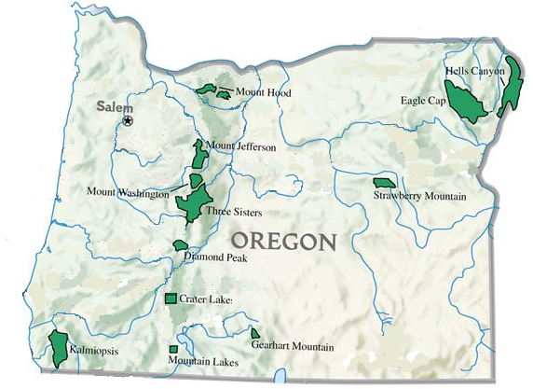
Oregon/Washington RH Plans
Oregon Class I Areas and IMPROVE monitors
Columbia Gorge Scenic Area
CORI1
MOHO1
HECA1
STAR1
THSI1
CRLA1
IMPROVE monitor
KALM1
Mandatory Class I area

Slide 54
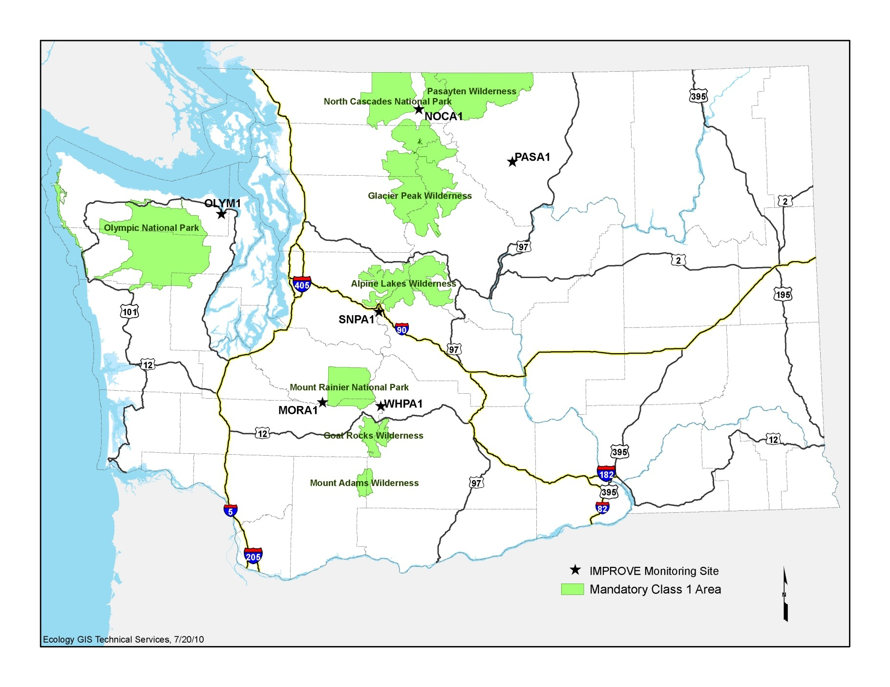
Oregon/Washington RH Plans
Washington Class I Areas and IMPROVE monitors
MAP GOES HERE
CORI1
Columbia Gorge
Scenic Area

Slide 55
Oregon/Washington RH Plans
Overview of EPA’s Regional Haze Rule
Adopted in 1999 - to address visibility problems in all156 Class I Areas over next 60 years.
Focused on improving 20% haziest days and protecting 20% clearest days in all Class I areas.
State must adopt plans that contain regional strategies to reduce haze from all sources. Strategies can rely on existing/other regulations.
Major requirement is BART (Best Available Retrofit Technology).
Progress reports every 5 years - major plan revisions every 10 years.

Slide 56
Oregon’s Regional Haze Plan
Adopted in 2010. Comprehensive analysis of visibility (haze) in Oregon’s 12 Class I areas.
Contains state and regional emission inventory and visibility projections for next 10 yrs (20% best/worst).
For 20% worst days, significant projected reductions by 2018 in SO₂ and NOx (“controllable sources”).
Contains DEQ’s BART review, including PGE Boardman controls and visibility improvements.
Progress report commitment (2015).
56

Slide 57
BART
Key part of the RHR. Retroactive evaluation of visibility impacts in Class I areas from older industrial sources permitted before 1977 for major sources >250 tons/year of any haze pollutant
BART determined case-by-case:
  Estimate the sources’ visibility impact thru modeling
  Does source have “significant” impact over 0.5 dv?
  If significant, conduct BART control evaluation.
57
Notes:
UP
One of the main provisions of the RHR and Section 308 is the BART requirement.
BART stands for….
and is a requirement for existing stationary sources.
R>
It applies to certain large industries over250 tons/year that began operating before 1977 – this was before national PSD rules were adopted to prevent new sources from causing visibility impairment in Class I areas.

Slide 58
Oregon DEQ BART Review
DEQ evaluated 101 potential BART-eligible sources.
10 sources found BART-eligible.
5 sources had “significant” impacts >0.5 dv threshold.
  4 sources took “federally enforceable permit limits” to reduce emissions and impact below 0.5 dv significance level.
  PGE Boardman only source underwent BART review.
58
Notes:
UP
One of the main provisions of the RHR and Section 308 is the BART requirement.
BART stands for….
and is a requirement for existing stationary sources.
R>
It applies to certain large industries over250 tons/year that began operating before 1977 – this was before national PSD rules were adopted to prevent new sources from causing visibility impairment in Class I areas.

Slide 59
PGE Boardman BART Review
PGE Boardman, 600-megawatt coal-fired power plant.
>25,000 tons annual emissions (mostly SO₂ and NOx).
BART modeling showed impacts >0.5 dv at 14 Class I areas in OR and WA, and CRGNA.
    highest at Mt Hood (4.9 dv), second highest at the Gorge (3.7 dv).
BART Controls summary:
  Install NOx controls 2011, SO₂ controls in 2014 & 2018
  Plant closure end of 2020
59
Notes:
UP
One of the main provisions of the RHR and Section 308 is the BART requirement.
BART stands for….
and is a requirement for existing stationary sources.
R>
It applies to certain large industries over250 tons/year that began operating before 1977 – this was before national PSD rules were adopted to prevent new sources from causing visibility impairment in Class I areas.

Slide 60
Washington’s Regional Haze Plan
Adopted in 2010. Very similar to Oregon’s:
  Comprehensive analysis of haze in 8 Class I areas.
  Worked with WRAP to develop state and regional emission inventory and visibility projections for 20% best and worst days.
  WDOE required BART for 7 industries, including TransAlta.
  BART focused on reducing the impacts of SO₂ and NOx on the 20% worst days.
  Progress report commitment (2015).
60

Slide 61
Washington DOE BART Review
WDOE identified 117 potential BART-eligible sources after screening out those without qualifying emissions or were built after 1977. 26 sources needed detailed evaluations
15 sources found BART-eligible and were modeled
7 sources had “significant” impacts (>0.5 dv threshold).
  3 sources installed BART controls, one source ceased operation.
EPA established BART for 3 sources
  Two to impose alternate SO₂ limitations
  One to allow for a better than BART alternative
61
Notes:
The 7 sources included the Weyerhaeuser Longview mill. 8 sources modeled out of BART

Slide 62
Centralia BART Review
TransAlta located in Centralia WA - 1300 MW coal fired power plant with 2 identical units.
Greater than 0.5 dv impact at 13 Class I areas within 300 km of its facility.
BART review limited to NOx. BART for SO₂ and PM evaluated and complied with in 2002.
Resulted in lower NOx emission limit reflecting change in coal and imposition of SNCR by state law.
62
Notes:
UP
One of the main provisions of the RHR and Section 308 is the BART requirement.
BART stands for….
and is a requirement for existing stationary sources.
R>
It applies to certain large industries over250 tons/year that began operating before 1977 – this was before national PSD rules were adopted to prevent new sources from causing visibility impairment in Class I areas.

Slide 63
Update to the Commission
Presentation Outline
Recap of DEQ/SWCAA presentation to Commission on 9/9/14
“Visibility 101”- what is visibility & regional haze?
Summary of past Gorge air quality/visibility study (2004-2011)
Gorge visibility trends
Overview of OR/WA Regional Haze Plans
Update on PGE Boardman & Centralia BART
Update on upcoming regional haze work
Wrap up

Slide 64
Update on PGE Boardman
Schedule for BART control installation
25,000
2011 (Low-NOx burners)
19%
2014 (DSI SO₂ controls)
20,000
reduction
2018 (DSI lower SO₂ limit)
Tons/year = SO₂ + NOx + PM
39%
15,000
reduction
48%
10,000
reduction
2020 closure
5,000
DSI pilot
Study
100%
reduction
2011
2014
2018
2020

Slide 65
Update on PGE Boardman
Schedule for emission reductions
and visibility improvements
BART controls timetable | Emission reduction tons/year (%) | Mt. Hood Visibility Improvement (dv)* | Gorge Visibility Improvement (dv)*
2010 (year adopted) | --- | 0 | 0
July 2011 | 4,800 (19%) | 1.44 | .92
July 2014 | 9,900 (39%) | 2.41 | 1.83
July 2018 | 12,400 (48%) | 2.75 | 1.95
Dec 2020 | 25,500 (100%) | 4.98 | 3.71
*modeling conducted by ODEQ
65
Notes:
UP
One of the main provisions of the RHR and Section 308 is the BART requirement.
BART stands for….
and is a requirement for existing stationary sources.
R>
It applies to certain large industries over250 tons/year that began operating before 1977 – this was before national PSD rules were adopted to prevent new sources from causing visibility impairment in Class I areas.

Slide 66
Update on Centralia Plant
BART control installation
All BART required controls installed, operating, and meeting emission limits.
One unit scheduled to cease operation by Dec. 31, 2020.
Other unit scheduled to cease operation by Dec. 31, 2025.
One unit may be replaced by a new natural gas turbine plant by 2025.

Slide 67
Update on Centralia Plant
Schedule for emission reductions
and visibility improvements
BART controls timetable | NO_{x} Emission reduction tons/year (%) | Mt. Hood Visibility Improvement (dv)* | Gorge Visibility Improvement (dv)*
2000-2005 baseline | --- | 0 | 0
2010 (Flex Fuels) | 3,139 (20%) | 1.13 | 0.80
2013 (SNCR) | 7,895 (50%) | 1.49 | 1.10
Dec 2020 - one unit shutdown | 11,795 (75%) | 2.48 | 1.82
Dec 2025 - second unit shutdown | 15,695 (100%) | 3.47 | 2.54
67
*modeling conducted by TransAlta
Notes:
UP
One of the main provisions of the RHR and Section 308 is the BART requirement.
BART stands for….
and is a requirement for existing stationary sources.
R>
It applies to certain large industries over250 tons/year that began operating before 1977 – this was before national PSD rules were adopted to prevent new sources from causing visibility impairment in Class I areas.

Slide 68
Update to the Commission
Presentation Outline
Recap of DEQ/SWCAA presentation to Commission on 9/9/14
“Visibility 101”- what is visibility & regional haze?
Summary of past Gorge air quality/visibility study (2004-2011)
Gorge visibility trends
Overview of OR/WA Regional Haze Plans
Update on PGE Boardman & Centralia BART
Update on upcoming regional haze work
Wrap up

Slide 69
2015 RH Progress Report Requirements
RH Progress reports due 5 years after submittal to EPA of first RH plan. OR and WA reports due in 2015.
Progress report requirements under 40 CFR 51.308(g):
  update on implementation of all measures
  summarize emissions reductions and visibility trends last 5 years
  analysis of significant changes
  statement of adequacy of existing plan
  review monitoring strategy
  FLM consultation
69

Slide 70
Preview of OR and WA 2015 Progress Reports
Oregon/Washington RH Plans
Both states - no degradation of the 20% best days.
Both states are seeing:
  Improvement of the 20% worst days – recent high wildfire years adversely affecting improvement trend.
  Emission reductions due to BART to date
  In both states, continuing to see significant reductions in SO₂ and NOx due to existing AQ regulations.
  Additional visibility improvements expected from new regulations, such as low-sulfur fuel requirements for offshore shipping.
70

Slide 71
2018 Comprehensive review/revision
Oregon/Washington RH Plans
All states must review and revise first RH plans.
Meet the requirements of 40 CFR 51.308(f):
  Described visibility improvements made to date.
  Develop new 10-year strategy to make reasonable progress.
  Additional measures needed to improve visibility.
  Include visibility projections for each Class I area.
  FLM consultation.
71

Slide 72
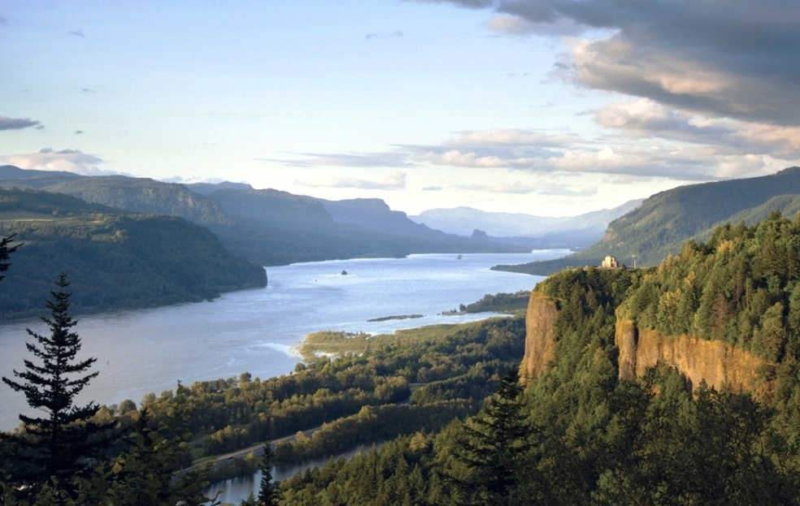
Gorge Visibility Summary
Good air quality in Gorge will continue to benefit visibility.
Slight improving trend to continue despite regional growth pressures.
There are visibility benefits from Regional Haze Program (e.g., Boardman BART) and long-term strategy to improve haze in Oregon/Washington.
Add’l benefits from on-going multitude of existing air quality state and federal programs to meet and protect public health.
72

Slide 73
thank you!
Oregon Department of Environmental Quality
Washington Department of Ecology
Washington Southwest Clean Air Agency
73

