Slide 1
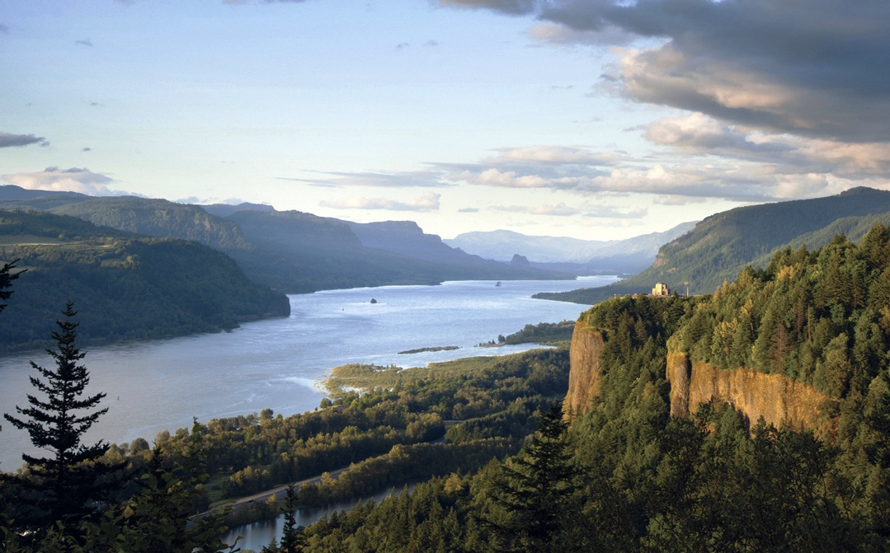

Columbia River Gorge Commission Meeting
Air Quality Update on Columbia River Gorge from Oregon DEQ and Washington SWCAA
September 9, 2014
Cascade Locks OR
Pavilion
Dick Pedersen, Director | Oregon Department of Environmental Quality Uri Papish, Director | Southwest Clean Air Agency

Slide 2
DEQ and SWCAA Update to Columbia Gorge Commission
Overview
Collaboration and partnership between air agencies and US Forest Service.
Past Gorge Air Quality Study conducted by DEQ & SWCAA.
Regional haze plans and upcoming work.
Highlight of current air quality trends.
More details to come in November.

Slide 3
DEQ and SWCAA Update
2011 Gorge Air Study and Strategy
2004 Start of work. Comprehensive study on sources causing air pollution in Gorge and strategies to improve visibility.
2007 DEQ & SWCAA host Gorge Science Day
2008 DEQ & SWCAA host Gorge Policy Day
2011 Both agencies present final report to Gorge Commission:
  most comprehensive air quality study ever done for any area in Oregon.
  contained recommendations to Commission for improving Gorge visibility.

Slide 4
DEQ and SWCAA Update
Key Findings from 2011 Gorge AQ Report
Sources causing air pollution are both local and distant.
Air quality is good, standards being met - haze levels not getting worse in spite of regional growth pressures.
Slight improving trend in Gorge visibility expected.
Gorge benefits from numerous regional AQ strategies, such as clean engine and fuel standards, and regional haze programs in OR and WA.
PGE Boardman coal-fired power plant largest individual contributor to haze pollution in Gorge.

Slide 5
DEQ and SWCAA Update
Commitments and Recommendations
Both agencies will continue to track air quality and visibility trends.
Visibility improvement most effectively achieved through the Regional Haze Program.
The goal should be for “continued improvement”.
DEQ will update Gorge Commission on regional haze work.
If tracking shows haze levels increasing, commitment to evaluate and consult with Gorge Commission.

Slide 6
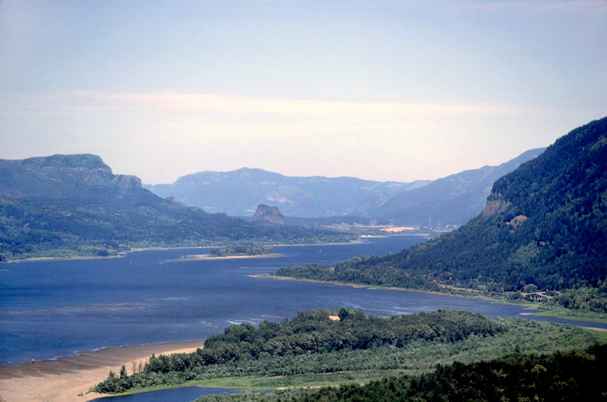
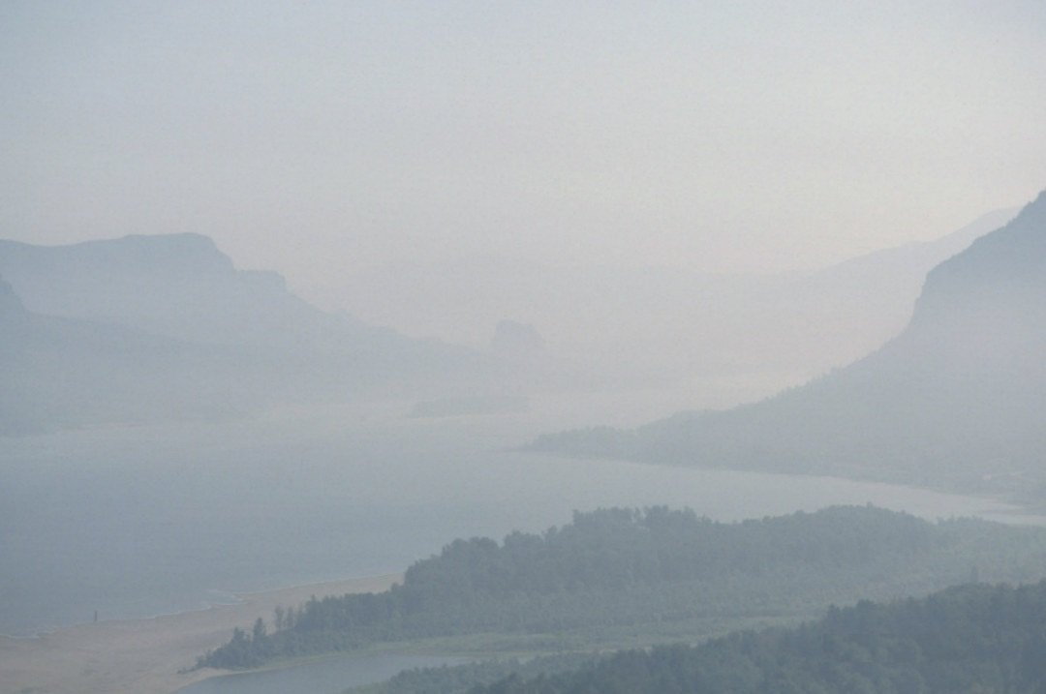
What is Regional Haze?
DEQ and SWCAA Update
Air pollution from many sources that travels long distances into scenic areas and affects visibility.
Good visibility = over 100 miles
Poor visibility = under 25 mi
Visibility in the Columbia River Gorge
6

Slide 7
Oregon and Washington haze plans
DEQ and SWCAA Update
Plans adopted in 2010 to meet federal Regional Haze Rule to improve Class I area visibility.
  Gorge not Class I area, but will benefit being close to Mt. Hood & Mt. Adams Class I areas.
Plans will result in significant visibility benefit to Gorge:
  Closure of PGE Boardman coal plant in 2020.
  Closure of TransAlta Centralia coal plant – one unit in 2020, one in 2025.
Progress reports due in 2015 – major plan revisions in 2018, with new long-term strategies for improving haze.
7

Slide 8
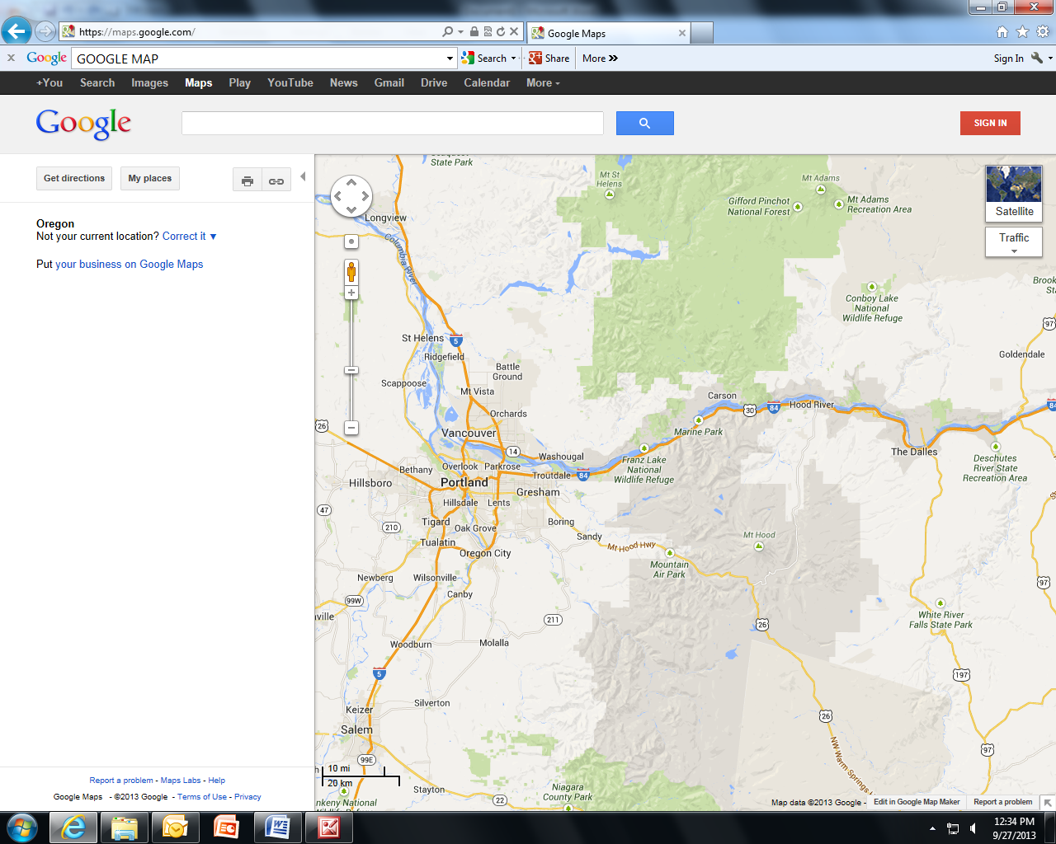
DEQ and SWCAA Update
Gorge visibility monitoring map
Columbia River Gorge National Scenic Area
WASHINGTON
Wishram site
Mt Zion site
(closed 2009)
OREGON
Mt. Hood Class I Area
monitoring site

Slide 9
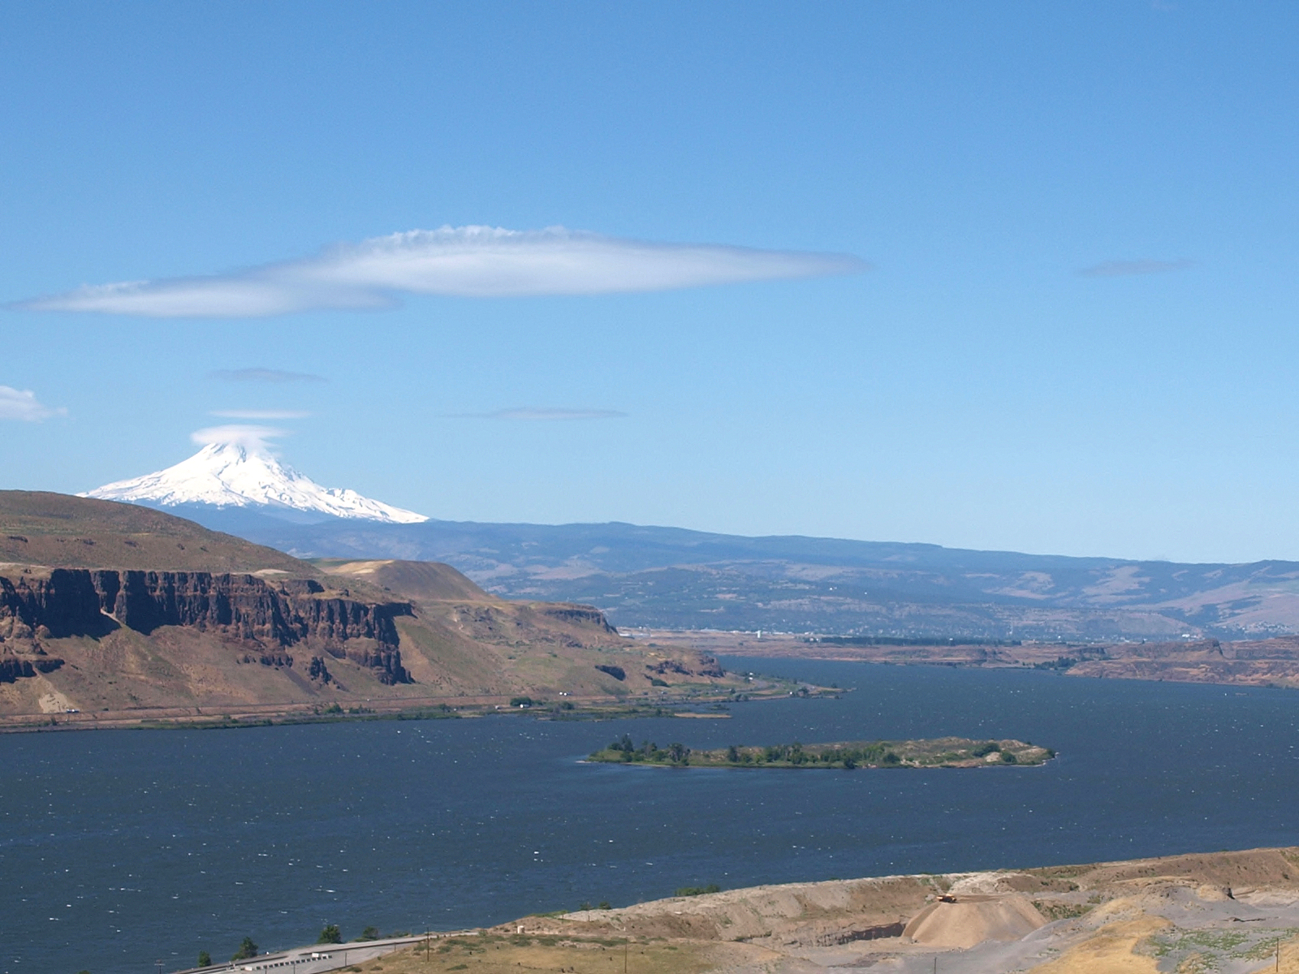
DEQ and SWCAA Update
View from Wishram monitor site
Looking southwest
Mt. Hood
The Dalles

Slide 10
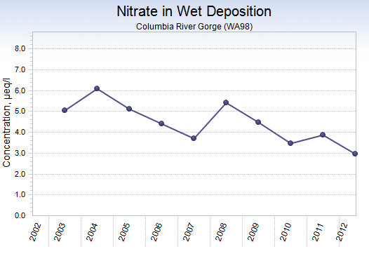
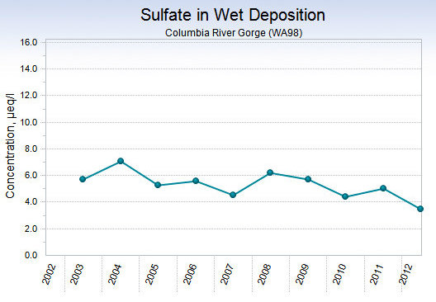
DEQ and SWCAA Update
Gorge pollutant trends 2003-2012
Nitrate and Sulfate impacts decreasing

Slide 11
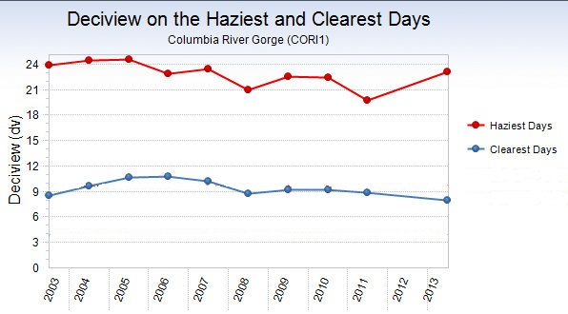
DEQ and SWCAA Update
Gorge visibility trends 2003-2013
Haziest and Clearest days – a slight improvement

Slide 12
DEQ and SWCAA Update
November Commission meeting
DEQ/SWCAA to provide more information on:
  Findings from the 2011 Gorge Air Study.
  Background on regional haze program and visibility trends in the Gorge.
  Estimated visibility improvement from PGE Boardman and Centralia plant.
  Preview of 2015 regional haze progress report and 2018 plan revision.

